Slide 1
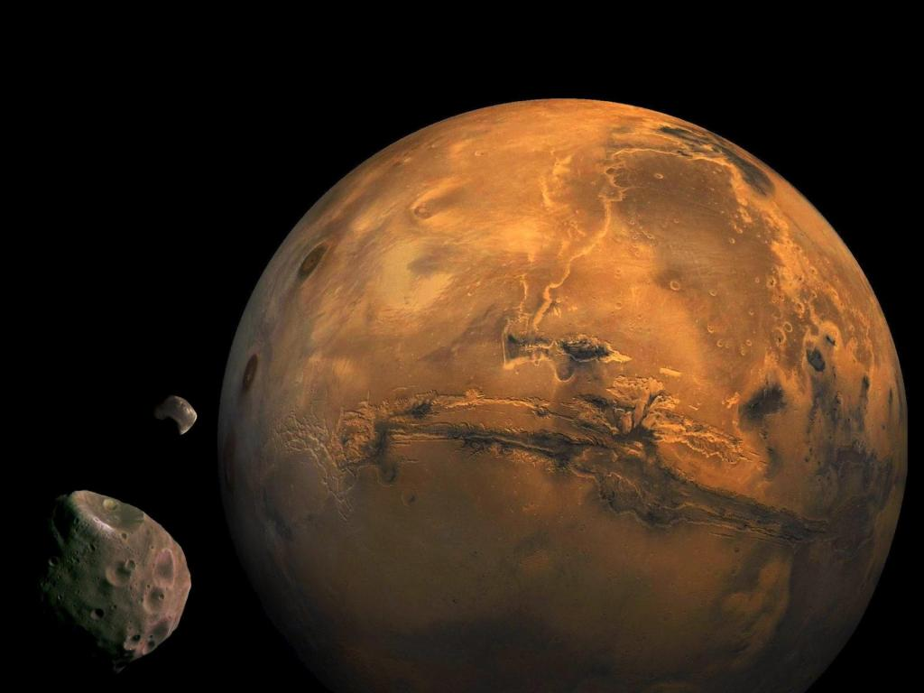
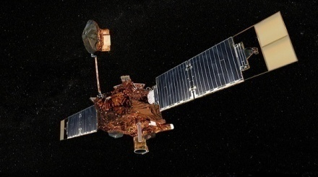
Mars
Click on the satellite to learn more about exploration of Mars
The Red Planet
Click on moon to learn more about Mars’ moons.
Click on Mars to learn more about the planet

Slide 2
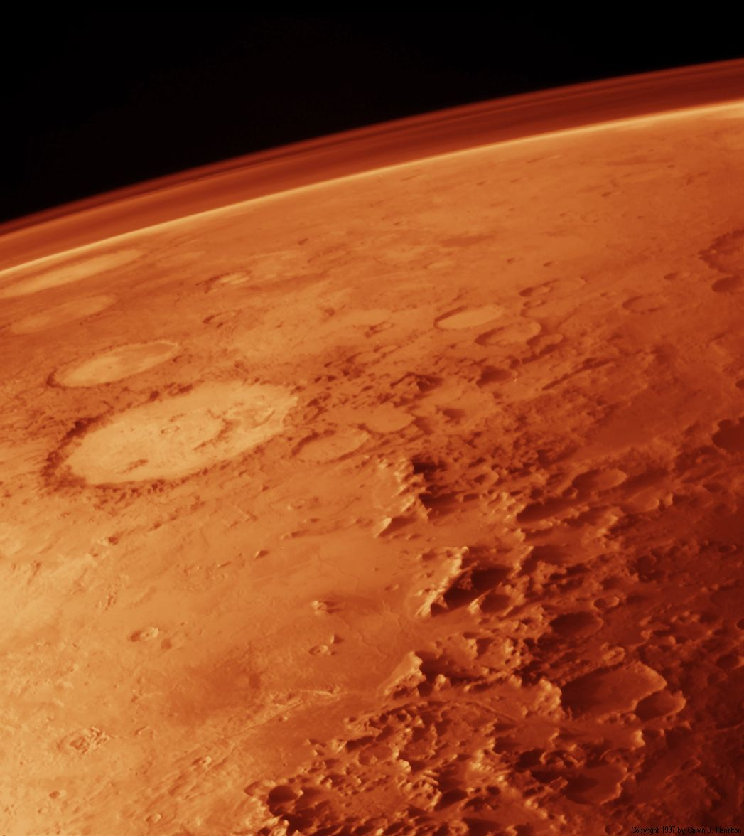
Planet Menu
Click here to learn more about Mars’ Atmosphere.
Click here to learn general information about Mars.
Click here to learn more about Martian surface features.

Slide 3
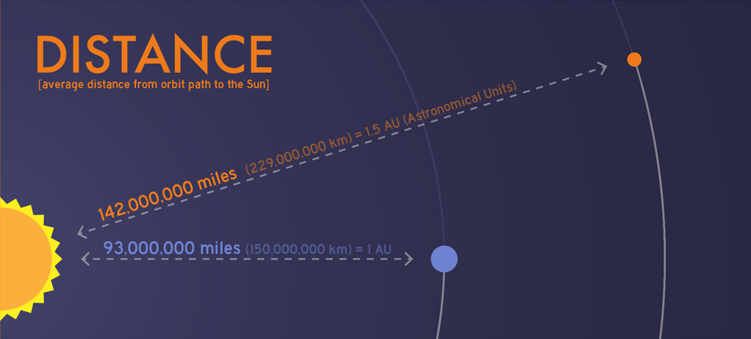
The Planet
Mars is about 1.5 times as far away from the Sun as Earth. This makes its year last about 687 Earth days.
Planet Menu

Slide 4
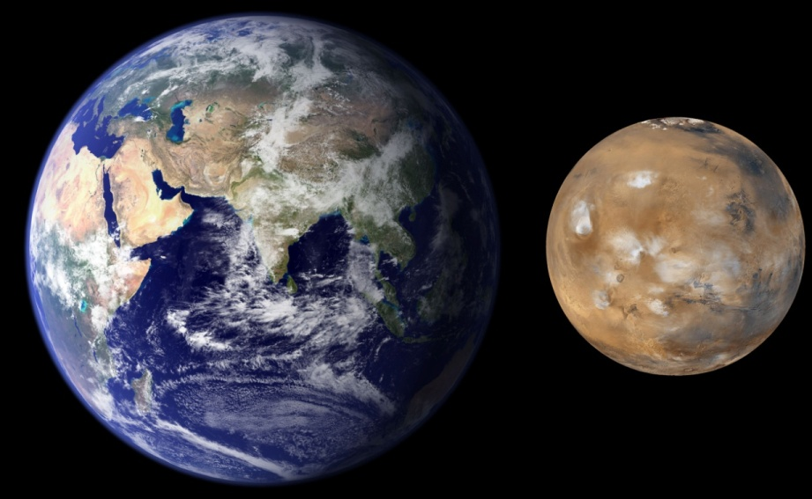
Mars and Earth
Mars is about half the size of Earth. This illustration shows the size difference between the two planets. Although Mars is smaller, has many similarities with Earth.
Planet Menu

Slide 5
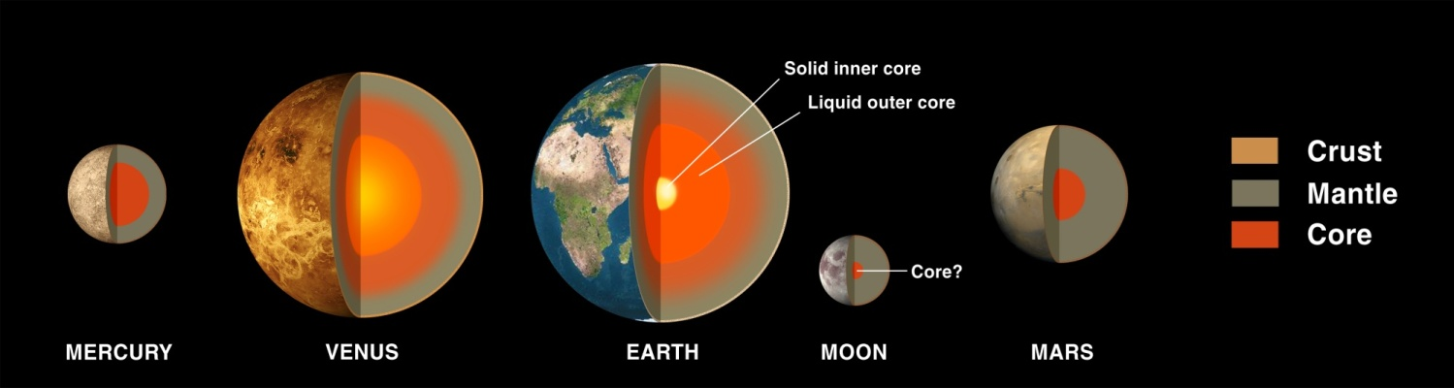
Terrestrial Planet
Mars is a terrestrial planet. That means that it is made of mostly solid matter, such as rock and metal.
Earth, Mars, Venus, and Mercury are all terrestrial planets.
Planet Menu

Slide 6
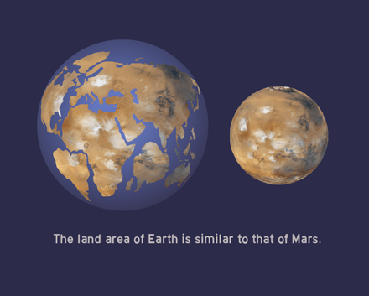
Martian Land
All of the water on Mars is either evaporated or frozen. This means that all of Mars is dry land.
Even though it is half the size of Earth, Mars has just as much dry land.
Planet Menu

Slide 7
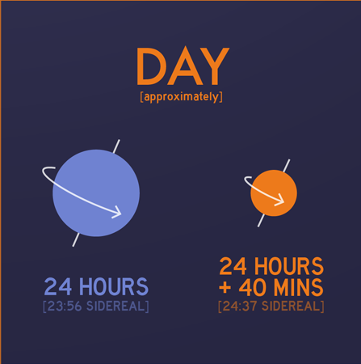
Mars and Earth Similarities
At 24 hours 37 minutes, the length of one day on Mars is almost the same as on Earth.
Planet Menu

Slide 8
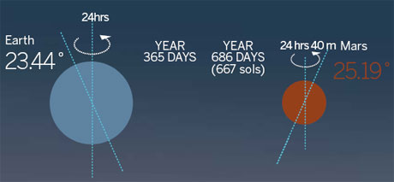
Mars and Earth Similarities
Mars is tilted on its axis of rotation like Earth.
Earth is tilted 23.5° and Mars is tilted 25°.
This means that Mars has seasons just like Earth. Because Mars’ orbit is almost twice as long, so are its seasons.
Planet Menu

Slide 9
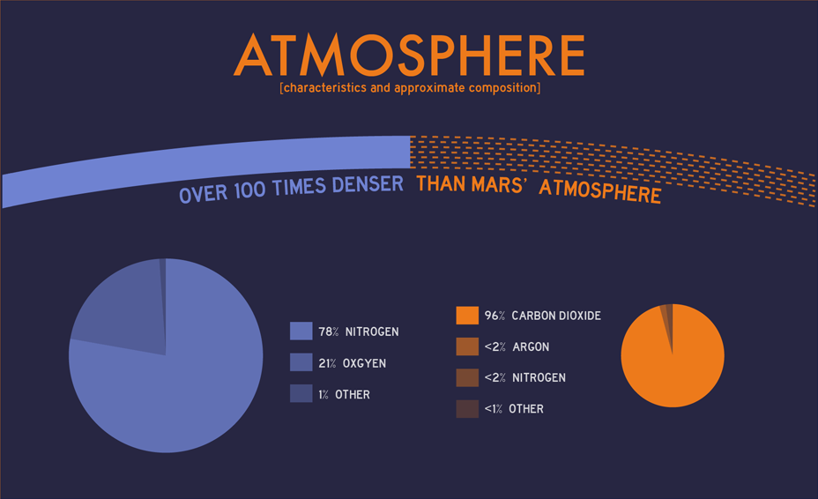
Martian Atmosphere
Mars has an atmosphere, but it is much different from Earth’s.
The atmosphere on Mars is made of 95% carbon dioxide. It is also much thinner than Earth’s, at only about 1% as dense.
Earth
Mars
Planet Menu

Slide 10
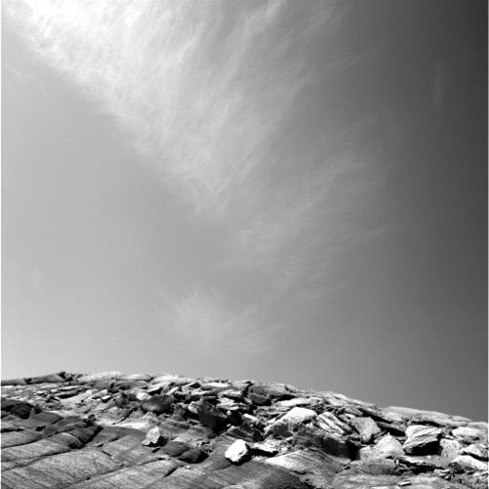
Martian Atmosphere
Although it is very thin, Mars’ atmosphere is still a dynamic system.
Probes have observed clouds and even snow in the higher latitudes.
Wispy clouds in the Martian atmosphere
Planet Menu

Slide 11
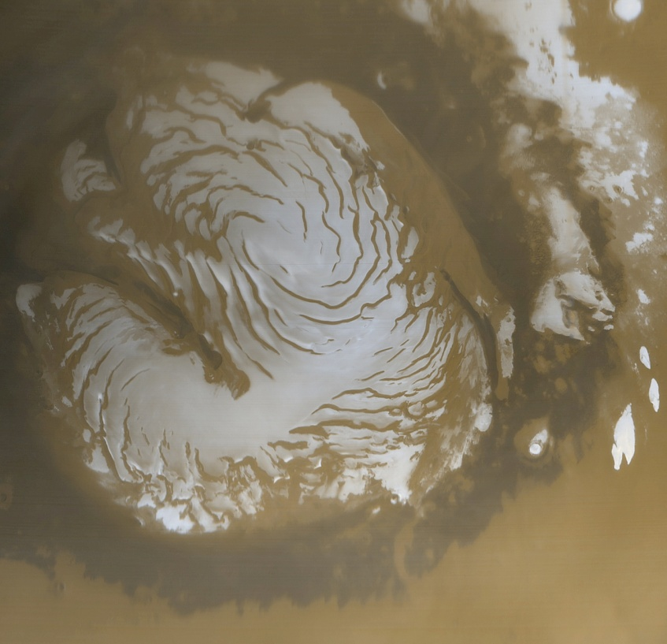
Martian Atmosphere
Because the pressure in the atmosphere is so low, water cannot exist in liquid form, although there is frozen water in the polar ice caps.
Mars’ northern polar ice cap
Planet Menu

Slide 12
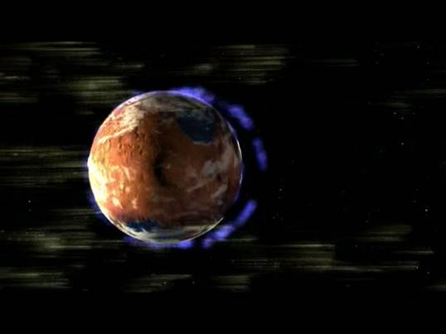
Mars’ Disappearing Atmosphere
The atmosphere of Mars was probably thicker in the past.
The Sun’s radiation is slowly stripping away gas from Mars.
But why is this happening?
Planet Menu

Slide 13
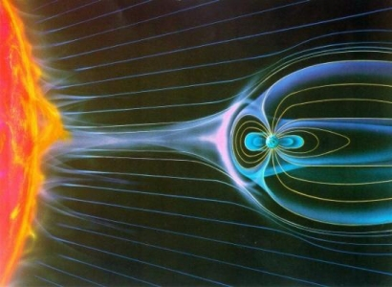
Mars’ Disappearing Atmosphere
Earth is able to keep its atmosphere because it is surrounded by a magnetic field, which blocks most of the solar wind particles.
Planet Menu

Slide 14
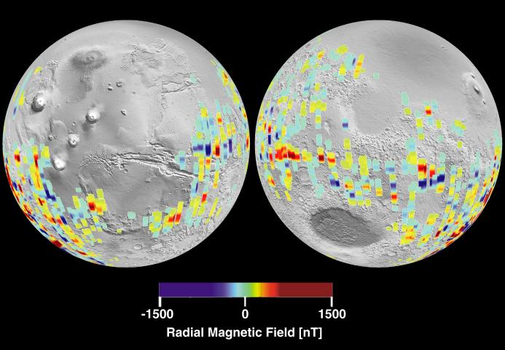
Mars’ Disappearing Atmosphere
Mars does not have a planetary magnetic field. There might have been one in the past, because probes have measured isolated regions which are very strongly magnetized.
Planet Menu

Slide 15
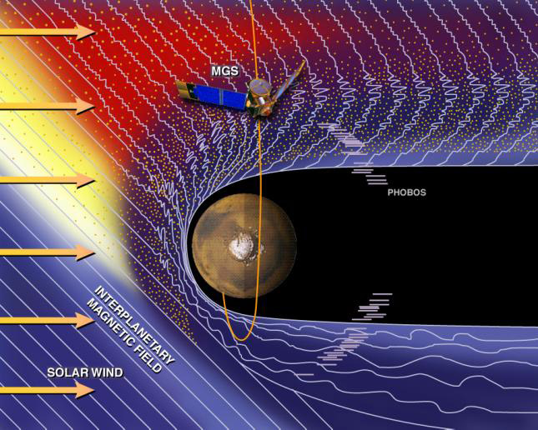
Mars’ Disappearing Atmosphere
Without a protective magnetic field, solar wind hits the Martian atmosphere directly.
This effect has been stripping away Mars’ atmosphere for billions of years.
Planet Menu

Slide 16
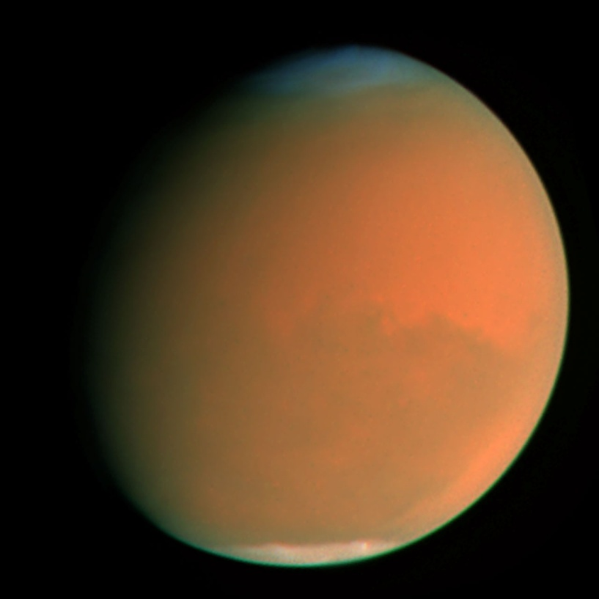
Dust Storms
One major type of event that occurs on Mars is enormous dust storms. These storms can cover the entire planet and last for a month or longer.
What is it about Mars that allows these storms to form?
Planet Menu

Slide 17
Clues about Dust Storms
?
There are at least three factors that contribute to the formation of giant dust storms:
Absence of liquid water
Relatively low gravity
Daily Temperature changes
?
?
Planet Menu

Slide 18
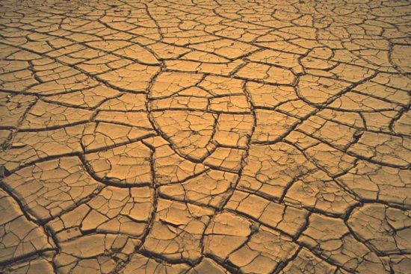
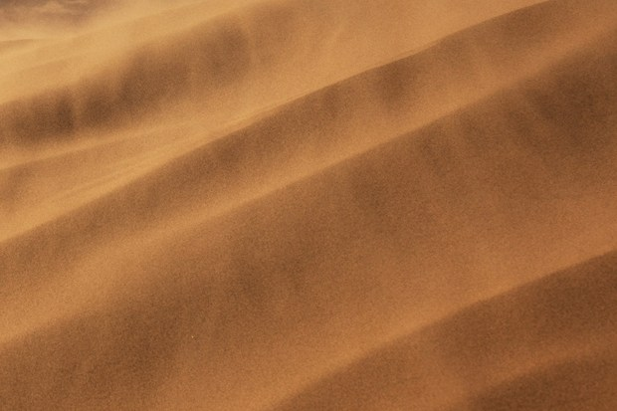
Clue 1: Aridness
Because there is no liquid water on Mars, dirt and dust never get clumped together by moisture in the air. These tiny particles are carried by the wind easily.
Planet Menu

Slide 19
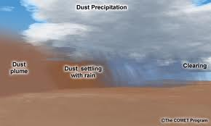
Clue 1: Aridness
Additionally, once dust particles are swept into the air, they do not get washed down by rain, as they would on Earth.
Planet Menu

Slide 20
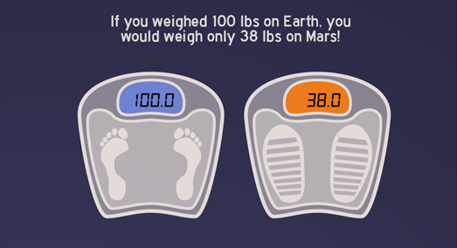
Clue 2: Low Martian Gravity
Mars is smaller and less dense than Earth, which means it has much less mass.
This causes gravity on Mars to be only about 38% as strong as on Earth.
Planet Menu

Slide 21
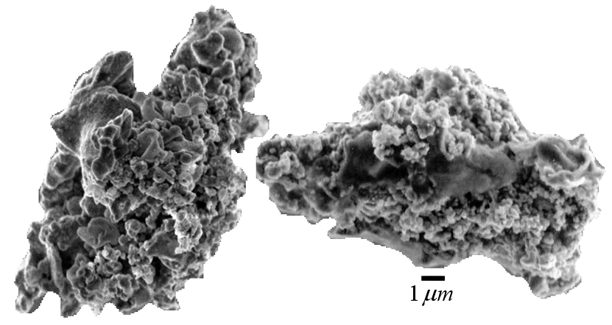
Clue 2: Low Martian Gravity
Extremely small objects, like dust particles, are barely affected by the low gravity on Mars.
This allows them to float in the air for longer periods.
Dust particles are measured on the micro-scale, that means they are about 0.000 01 meters long.
Planet Menu

Slide 22
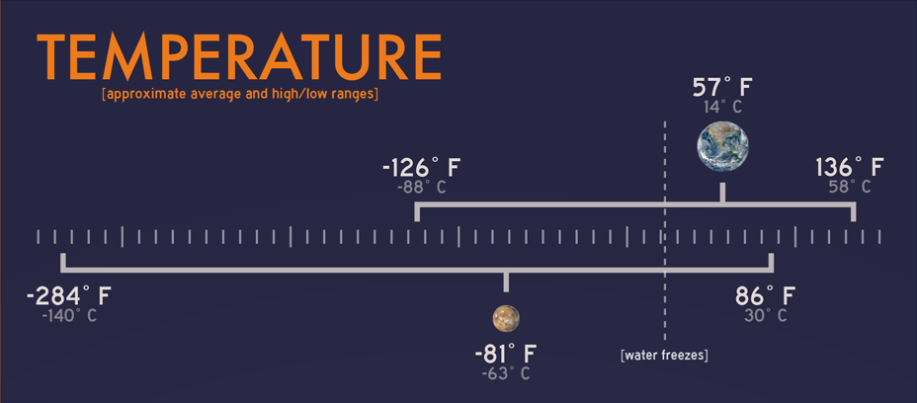
Clue 3: Daily temperature changes
As Mars rotates, the temperature changes as day turns into night, just like on Earth.
However, on Mars, the temperature change is much bigger.
Planet Menu

Slide 23
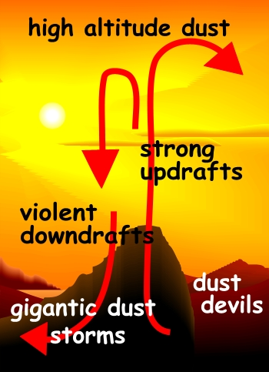
Clue 3: Daily temperature changes
This wide variation of temperatures is what drives strong winds.
As air cools or heats up, it sinks or rises. Large temperature changes cause large air movements.
Planet Menu

Slide 24
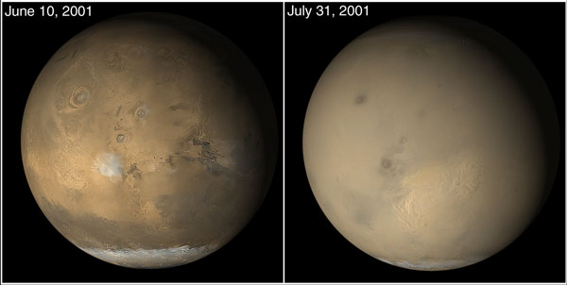
Martian Dust Storms
These are only some of the factors that cause Martian dust storms.
The more scientists learn about Mars, the better they will understand these storms.
Planet Menu

Slide 25
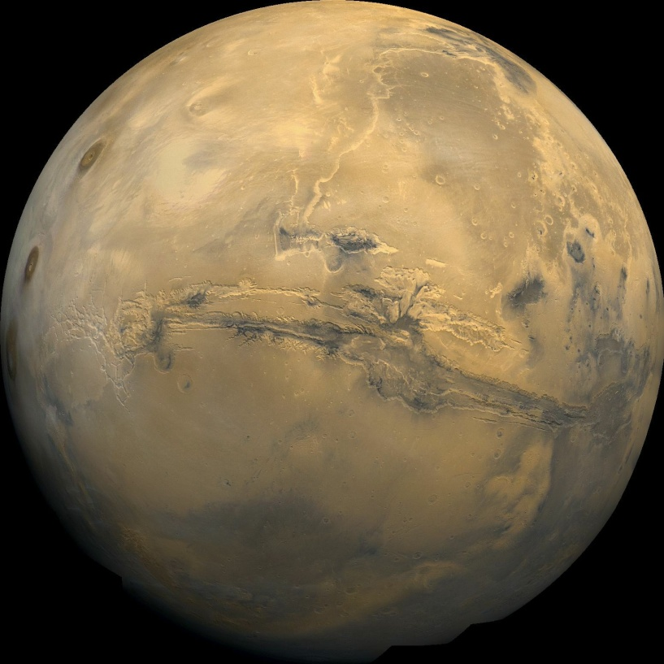
Martian Surface Features
As this Viking I picture shows, the surface of Mars is a diverse and interesting place.
Mars has many of the same types of terrain that Earth has.
Planet Menu

Slide 26
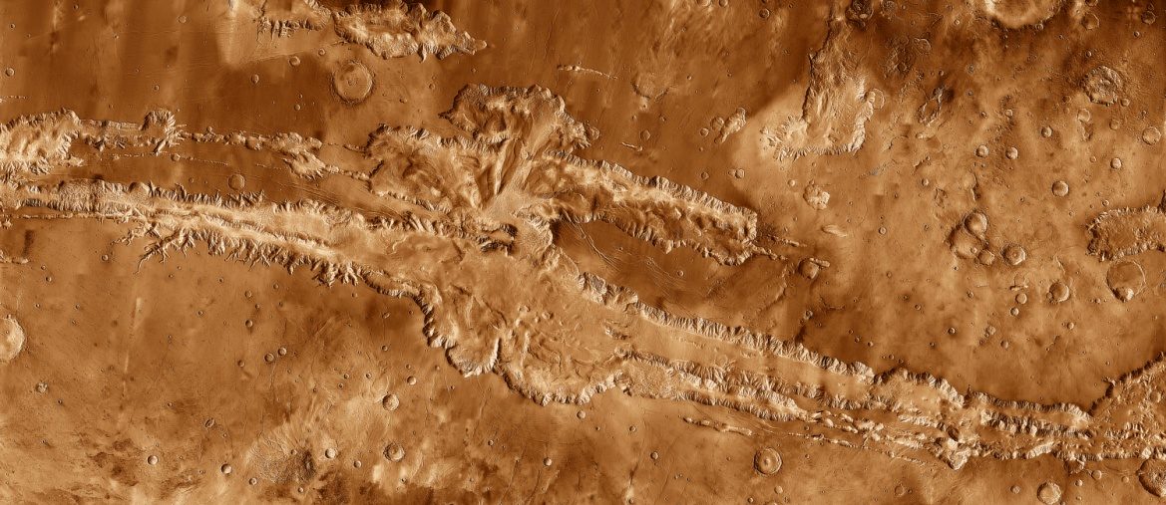
Valleys
One of the most prominent features of the Martian surface is Valles Marineris.
This enormous valley can be seen from space.
Planet Menu

Slide 27
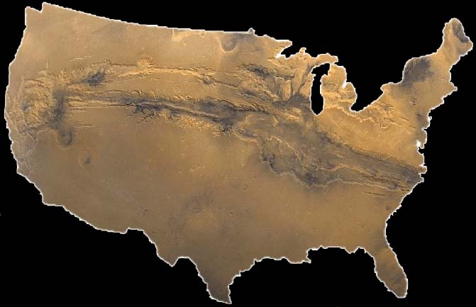
Valles Marineris
This image shows a size comparison of Valles Marineris and the continental United States.
Planet Menu

Slide 28
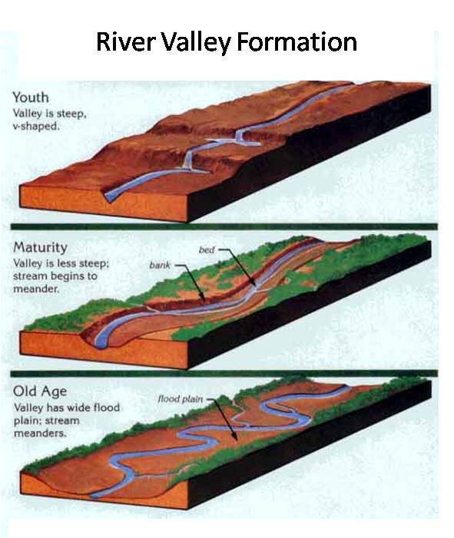
Valleys
Valles Marineris is not the same as most other valleys on Mars.
Normally, a Martian valley is created when flowing water erodes the landscape over long periods of time
Planet Menu

Slide 29
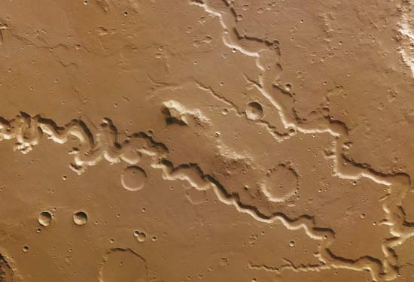
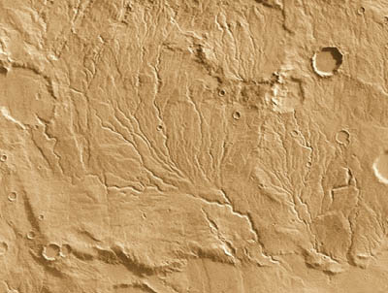
Martian River Valleys
There are thousands of river valleys on Mars. This is a key piece of evidence for the existence of liquid water on Mars in the past.
Two examples of river valleys on Mars
Planet Menu

Slide 30
Valles Marineris
Tharsis Region
Valles Marineris formed from intense pressure build-up beneath the crust of the planet billions of years ago, in a region called Tharsis.
Planet Menu

Slide 31
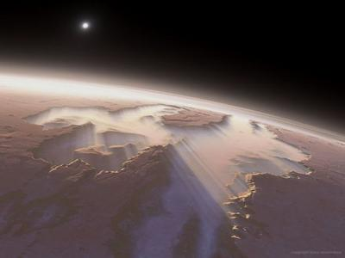
Valles Marineris
Once the pressure became too great for the Martian planetary crust to withstand, the surface literally split open.
Planet Menu

Slide 32
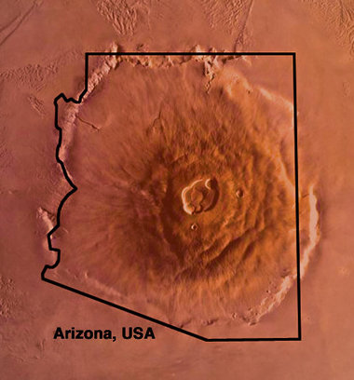
Volcanoes
Mars is home to extremely large volcanoes, including Olympus Mons, the largest volcano in the Solar System.
Olympus Mons is about as big as Arizona.
Planet Menu

Slide 33
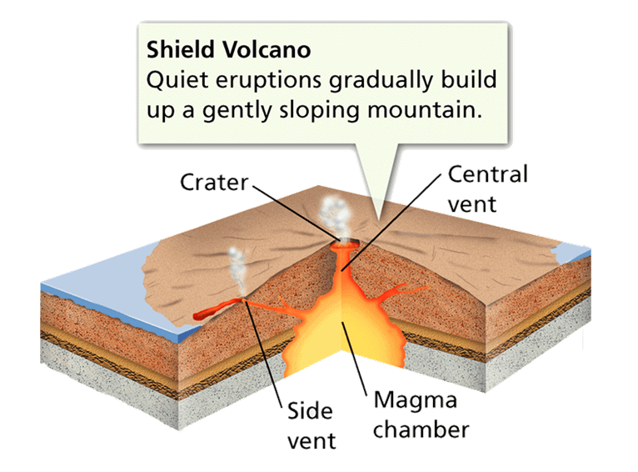
Volcanoes
Martian volcanoes are shield volcanoes, similar to ones found in Hawaii on Earth.
But why are Martian volcanoes so big?
Planet Menu

Slide 34
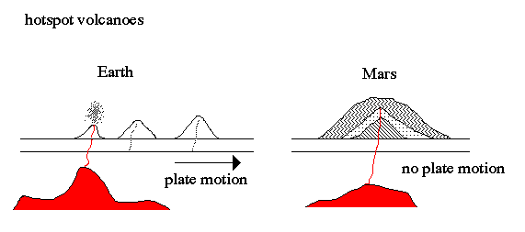
Martian Volcanoes
Mars is different from Earth in that it does not have several tectonic plates that move around over the planet’s mantle layer.
Planet Menu

Slide 35
Martian Volcanoes
Because eruptions happened over the same spot on Mars’ surface for millions of years, material was deposited on the same spot, which created giant volcanoes.
Planet Menu

Slide 36
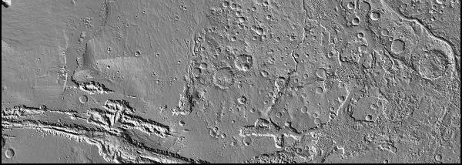
Craters
Mars has craters just like every other solid body in the Solar System.
Planet Menu

Slide 37
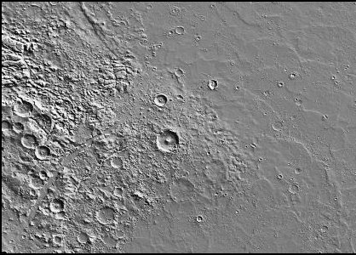
Craters
Large numbers of craters on a particular portion of the Martian surface tell planetary geologists that the surface is older than a portion with few craters.
Newer terrain
Older terrain
Planet Menu

Slide 38
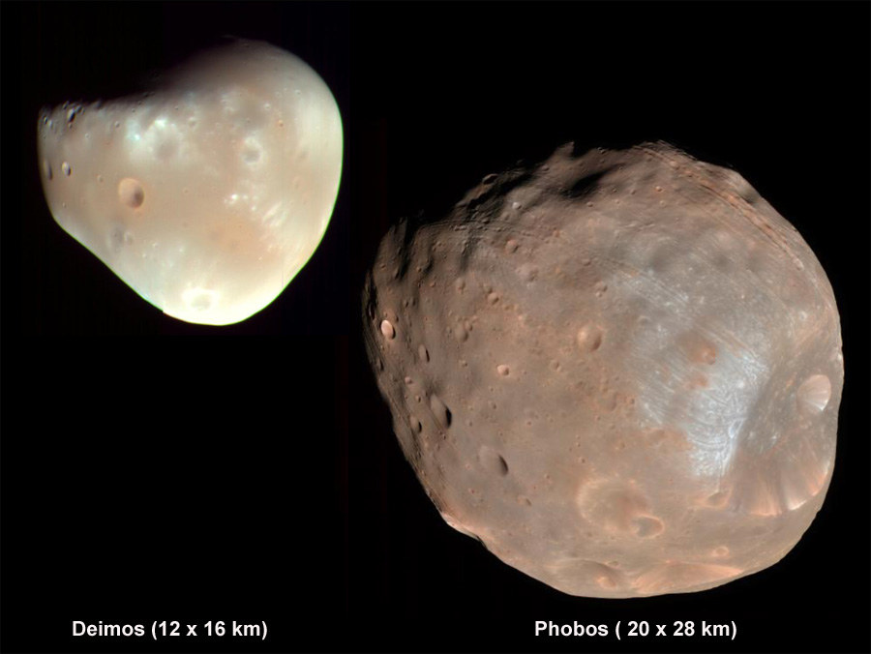
Martian Moons
Mars has two moons, Deimos and Phobos.
Although they are very small, there is a lot to learn about them.
Deimos
Phobos

Slide 39
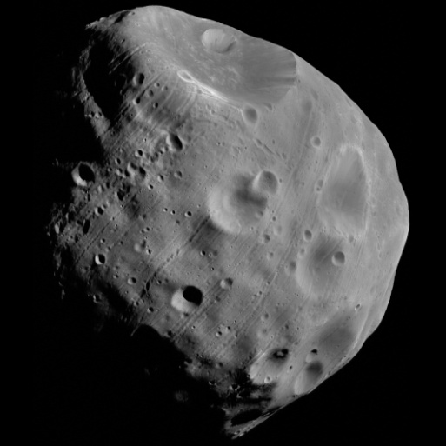
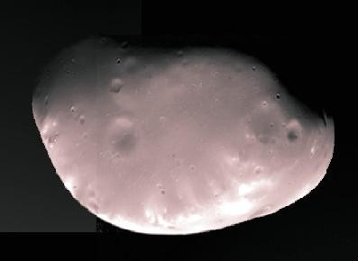
Martian Moon Shape
The moons of Mars are not spherically shaped like Earth’s Moon.
This is because the moons are not massive enough to pull themselves into sphere shapes.
Deimos
Phobos

Slide 40
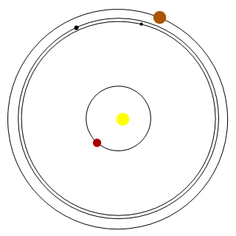
Origin of Martian Moons
Deimos and Phobos are probably captured asteroids.
These two objects were disturbed from their previous orbits by Mars’ gravity, and now they orbit as moons.

Slide 41
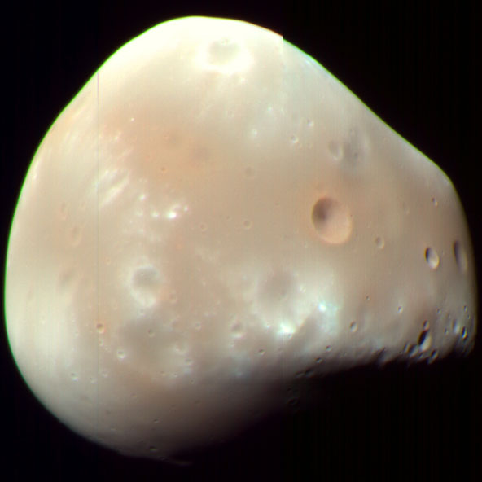
Deimos
Deimos’ longest side is only about 9 miles.
Deimos and Phobos look very much like asteroids.

Slide 42
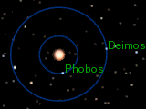
Deimos
Deimos completes one orbit around Mars every 30.3 hours.
This means that this moon stays in the Martian sky for over two and a half days once it rises.

Slide 43
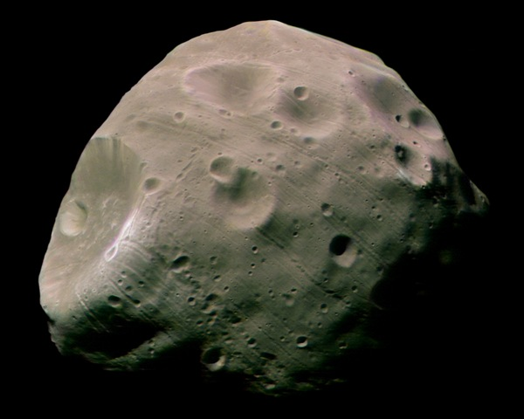
Phobos
This moon is the larger of Mars’ moons. Its longer diameter is under 14 miles long.
It is also orbits closer to Mars than Deimos.

Slide 44
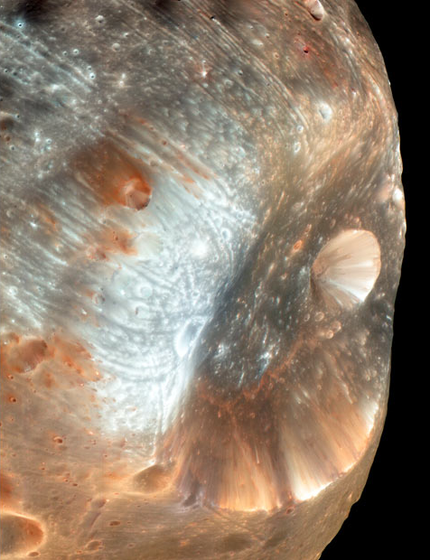
Phobos
Phobos’ orbit only takes about 7 hours and 40 minutes.
This is so fast that the moon rises over the West horizon and sets in the East.

Slide 45
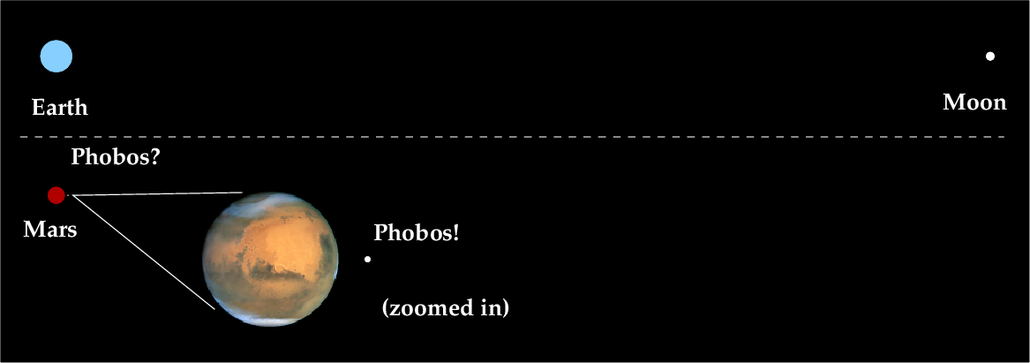
Phobos
Phobos orbits closer to its host planet than any other moon in the Solar System.
In fact, Phobos is orbiting too close to Mars!

Slide 46
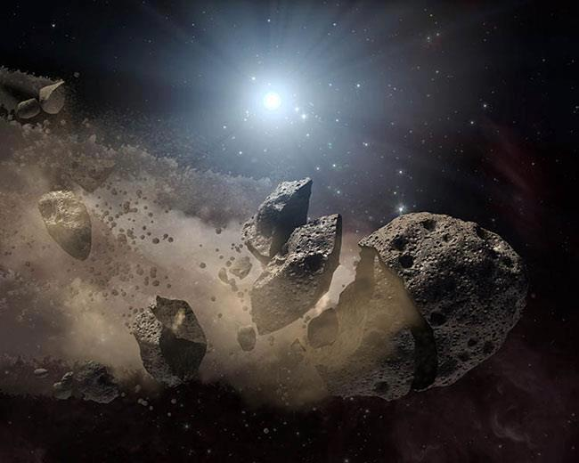
Mars’ Doomed Moon
Phobos is so close to Mars that it is slowly falling towards the planet.
It will probably be pulled apart by Martian gravity in about 50 million years.

Slide 47
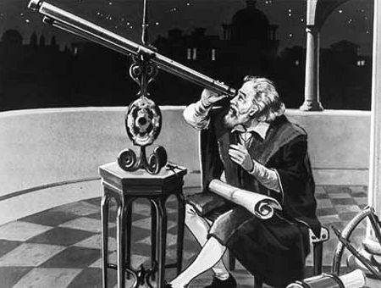
Exploration of Mars
Exploration of Mars has been happening since people started looking at it with telescopes.
It wasn’t until the 20th Century that we started sending probes to Mars.

Slide 48
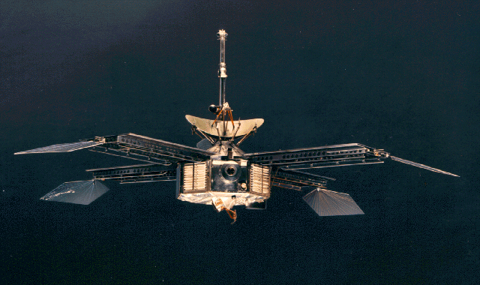
Mariner 4
The first probe to successfully reach Mars was Mariner 4 in July 1965. Three more Mariner spacecrafts were sent to Mars in following years.

Slide 49
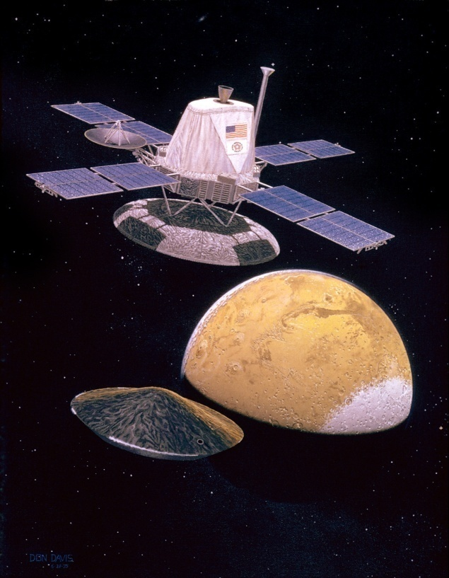
Viking I and II
The Viking missions included orbiters and surface landers.

Slide 50

In 1975, Viking 1 was the first spacecraft to successfully land on Mars. These landers discovered that all the elements essential for life exist on Mars.

Slide 51

In 1993 NASA organized its plans for Mars by starting the Mars Exploration Program.

Slide 52

Pathfinder/ Sojourner
Sojourner was the first rover mission ever sent to Mars. The information it gathered showed that water most likely existed for a long period of time in Mars’ past.

Slide 53

Mars Global Surveyor
Mars Global surveyor used laser altimeter measurements to provide highly accurate topographic maps of the surface, including canyons in the ice caps. It also found deposits of the mineral hematite, which only forms in wet conditions.

Slide 54

Mars Odyssey
Mars Odyssey mapped the chemical elements contained in the Martian surface. This led to the discovery of large amounts of water ice in the polar ice caps.

Slide 55

Mars Express
Mars Express is a mission run by the European Space Agency. Its orbit is inclined 86.3 degrees from the equator so it can study Mars’ polar ice caps. It has discovered that the ice caps are made of about 85% frozen Carbon Dioxide (dry ice) and 15% frozen water.

Slide 56

Mars Exploration Rovers
Spirit and Opportunity both found rocks that only form in the presence of water: basalt and gypsum. This provides strong evidence for the existence of water on Mars millions of years ago.

Slide 57

Mars Reconnaissance Orbiter
This satellite is equipped with the largest camera ever sent to another planet, and is capable of scanning the surface and shallow subsurface of Mars.
It discovered city-sized subsurface glaciers, which could be a vital source of water for human explorers.

Slide 58

Phoenix
This probe landed near Mars’ northern polar ice cap. It was the first mission to study that region of Mars’ surface.
Phoenix observed clouds made of water ice and snow. It found clay and calcium carbonate in soil samples, both of which form in wet areas.

Slide 59

Curiosity
By taking measurements during its interplanetary flight, Curiosity discovered that there is a dangerously high level of radiation in space between Earth and Mars.
Once on Mars, another of its discoveries was an ancient lakebed that could have supported life.

Slide 60

MAVEN (Mars Atmosphere and Volatile Evolution)
MAVEN has sensors designed to measure Mars’ atmosphere in several ways. These measurements will help determine why Mars is losing its atmosphere.

